Slide 1
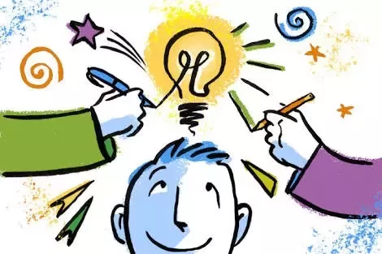
Intelligence and creativity
UNIT-IV

Slide 2
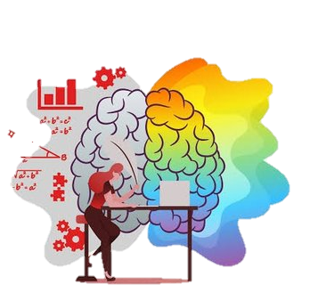
. Meaning of Intelligence
. Types of intelligence
. Different theories of intelligence
. Two- factor theory of intelligence
. Gardener ‘s multiple intelligences
. Triarchic theory of intelligence
. Two factor Thurston’s group factor
.Thurston’s theory of intelligence
. Thurston's theory of intelligence
. Thorndike’s multifactor of intelligence
. Abilities in multiple intelligence theory
. Guilford’s structure of intellect and gardener multiple intelligence
. Gardener‘s multiple of intelligence
. Intelligence quotient

Slide 3
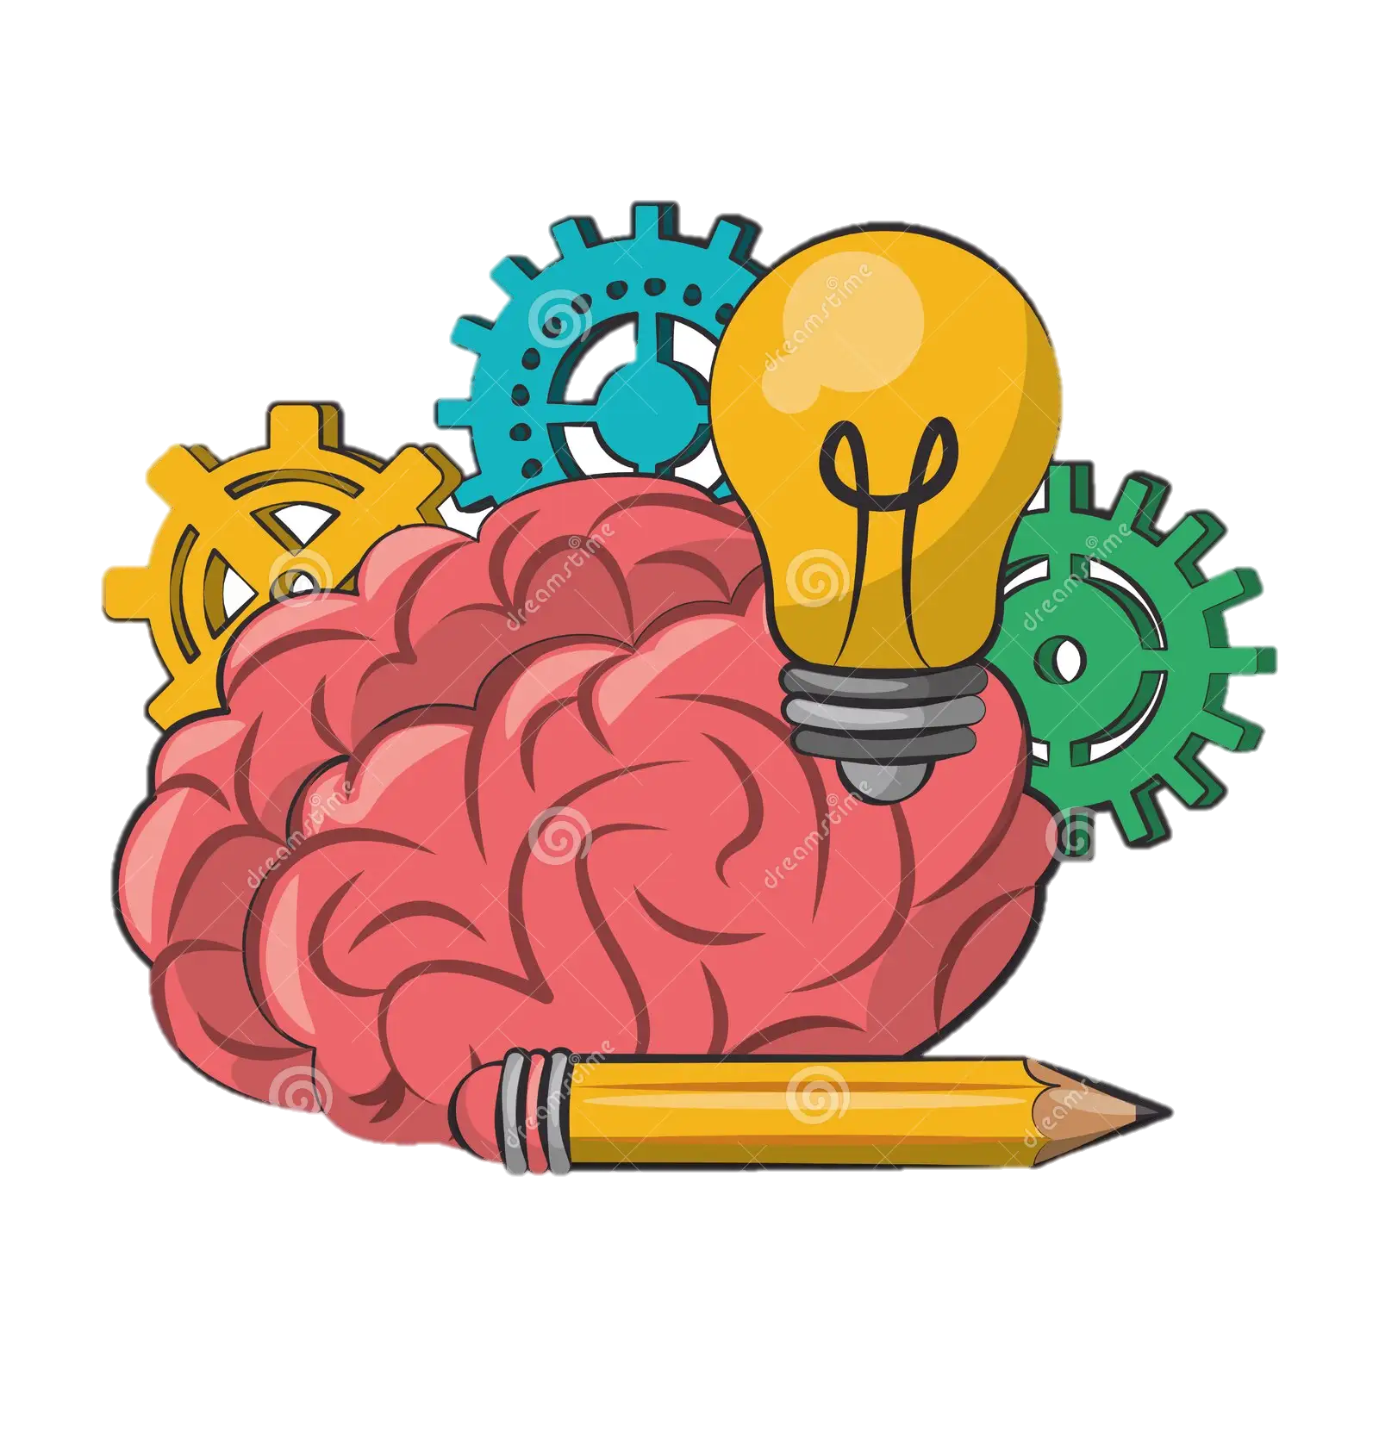
. Assessment of intelligence
. Intelligence assessment
. Creativity
. Concept, factor and of process
. Strategies for fostering creativity

Slide 4
. Meaning of intelligence
Intelligence has been defined in many ways: higher level abilities(such as abstract reasoning representation, problem solving, and decision making ) the abilities to learn, emotional knowledge, creativity, and adaptation to meet the demands of the environment effectively .
Intelligence can be defined as the ability to solve complex problems or make decisions with outcomes benefiting the actor, and has evolved in lifeforms to adapt to diverse environments for their survival and reproduction.
psychologist Robert Sternberg denied intelligence as "the mental abilities necessary for adaption to, as well as shaping and Selection of, any environment we’re all familiar with the standard methods of measuring intelligence.

Slide 5
Intelligence Definition
The definition of Intelligence is the ability to gather knowledge and skills and
apply them to your life. This means that an intelligent person can reason and
understand their way through life, and not just act on instinct.
Your intelligence is fluid and adaptable. And if you develop skills
outside your comfort zone, you can adapt challenges more easily.
. Types of intelligence
1. Naturalistic Intelligence
Naturalistic intelligence designates the human ability to discriminate among living things(plants, animals) as well as sensitivity to other features of the natural world(clouds, rock configurations). This ability was clearly of value in our evolutionary past as hunters, gatherers and farmers,

Slide 6
2. Musical Intelligence
Musical intelligence is the capacity to discern pitch, rhythm, timbre, and tone. This intelligence enables us to recognize, create, reproduce, and reflect on music, as demonstrated by composers, conductors, Musicians, vocalist, and sensitive listeners.
3. Logical-Mathematical Intelligence
Logical-mathematical intelligence is the ability to calculate
Quantify, consider propositions and hypotheses, and carry
Out complete mathematical operations.
4. Existential Intelligence
Sensitivity and capacity to tackle deep questions about human existence, such as the meaning of Life, why we die, and how did we get here.

Slide 7
5. Interpersonal Intelligence
Interpersonal intelligence is he ability to understand and interact effectively with others. It involves effective verbal and nonverbal communication, the ability to note distinctions among others, sensitivity to the moods and temperaments of others, and the ability to entertain multiple perspectives.
6. Bodily-Kinesthetic Intelligence
Bodily kinesthetic intelligence is the capacity to manipulate objects and use a variety of physical skills. This intelligence also involves a sense of timing and the perfection of skills through mind-body union.
Athletes dancers, surgeons and crafts people exhibit well-developed bodily kinesthetic intelligence.
7. Linguistic Intelligence
Linguistic intelligence is the ability to think in words and to use language to express and appreciate complex meanings. Linguistic intelligence allows us to understand the order and meaning of words and to apply meta-linguistic skills to reflect on our use of language.

Slide 8
8. Intra-personal Intelligence
Intra-personal intelligence is the capacity to understand oneself and one’s thoughts and feelings, and to use such knowledge in planning and directioning one’s life. Intra-personal intelligence involves not only an appreciation of the self, but also of the human condition.
9. Spatial Intelligence
Spatial intelligence is the ability to think in three dimensions. Core capacities include mental imagery, Spatial reasoning, image manipulation, graphic and artistic skills, and an active imagination.
Different Theories of Intelligence
Here are some of the major theories of intelligence developed by some of the
most well-known psychologists.

Slide 9
Two-Factor Theory of Intelligence
Charles Spearman, a British psychologist, came up with one of the earliest theories of intelligence. He studied the results of the test conducted by Binet and Simon. He noticed that students who performed Well in one subject were likely to perform well in corresponding subjects. For example, he saw that a student who performed well in math also performed well in music.
IQ or intelligence quotient tests, which measures one’s general cognitive abilities, are derived from Spearman’s theory of general intelligence.
Gardener’s Multiple Intelligence
Howard Gardner, a developmental psychologist, was best known for his multiple intelligence theory. He believed that the traditional test of intelligence didn’t accurately depict a person’s abilities. He Outlined eight major types of intelligence:

Slide 10
1. Naturalist Intelligence
The first intelligence of Gardner’s theory of multiple intelligences is naturalist intelligence. Being able to read and understand nature, and all the living things in and on it is also a type of intelligence. Having sensitivity to all living and nonliving elements in nature makes you “nature smart.”
2. Musical Intelligence
Having the ability to recognize and produce, sound, rhythm, pitch and timbre.
3. Logical-Mathematical Intelligence
This type of intelligence describes superior inductive and deductive reasoning and calculating ability so that anyone who possesses it can think conceptually and abstractly. In any given position, they get it very easy to recognize trends and patterns and know relationships. Order and sequencing figure considerably in your thinking manners.
4. Bodily-Kinesthetic Intelligence
The ability to control the physical form, like your bodily movements, and be
Effective physical communicators.

Slide 11
5. Verbal Linguistic Intelligence
The ability to convey or communicate ideas, feelings or theories. There’s
sensitivity to sound and meaning of words.
6. Visual -Spatial Intelligence
The ability to relate well to the surrounding environment. It’s the capacity to
Visualize thoughts and draw mental maps.
7. Interpersonal Intelligence
The ability to understand others by using emotional intelligence. It’s the capacity
To detect the mood and motivation of others.
8. Intrapersonal Intelligence
The ability to be self-aware and self-knowing. It’s also called the intelligence of
The self.
Triarchic Theory of Intelligence
American psychologist Robert Sternberg proposed the Triarchic Theory just two
Years after Gardener’s theory. It was a three-category approach that addressed
The gaps in Gardner’s theory of intelligence in psychology. He found Gardner’s
Definition of intelligence as a much broader, single and general ability.

Slide 12
According to Sternberg, the concept of intelligence involves three different
factors:
Analytical intelligence
It refers to a person’s ability to assess information and how they use the
Information to analyze problems and arrive at solution.
Creative intelligence
The ability to do something in a novel or innovative way in order to create
New idea or experience. It involves imagination and problem- solving
Skills.
Practical Intelligence
The ability to solve problems in daily life and adapt to changing environments.
People with practical intelligence are also called "street smart”.
Conclusion:
Everybody’s intelligence is unique and everyone thinks and reasons
Differently. What matters at the end of the day is how we use our intelligence.

Slide 13
Two Factor Thurston’s Group Factor
Thurston's Group Factor Theory Louis Thurston came out with the group factor theory (1937) saying that Intelligence is a cluster of abilities These mental operations then constitute a group  A second group of mental operations has its own unifying Primary factor; a third group has a third Primary factor and so on.
The abilities that he identified are as follows:
Spatial factor: It is involved in visualizing shapes.
Verbal factor: It is concerned with comprehension of verbal ideas.
Word fluency factor: It is involved whenever the subject is asked to think of
Isolated words at a rapid rate.
Numerical factor: It is the ability to do numerical calculations.
Memory factor: It is the ability to memorize quickly.
Inductive Reasoning factor: It is the ability to draw inferences.
Perceptual factor: It is the ability to perceive objects accurately.
Deductive Reasoning factor: It is the ability to make use of generalized results.

Slide 14
9. Problem-solving ability factor: It is the ability to solve problems independently.
10. The weakest aspect of the group factor theory was that it discarded the
concept of the common factor.
11. Louis Thurston proceed out with the group factor theory(1937)saying that
intelligence is a cluster of abilities.
12.These mental operations then comprise a group.
13. A second group of mental operations has is own merging primary factor
A third group has a third primary factor and so on.
14. Each of them has its own primary factor.
15. Each of these primary factors is said to be corresponding independent of
Others.
16. He explained that there were seven primary mental abilities and later on
added two more.
17. Promoted greatly to the measurement attitudes Thurston scale developed in
1928 was the first formal techniques for measuring of attitude.
18. Thurston’s theory of intelligence was a major impact on later theories of
multiple intelligences, such as those of Guilford, Gardner, and Sternberg.

Slide 15
19. Developed a relative judgment scaling technique rank scale, can be used
to rank all possible Feelings related to an issue and to categorize people
expressing an opinion based on the rank of that Opinion.
20. If the person wants to perform any specific activity, one or more of these
factors or abilities are involved. Some of them are more important than others.
Thurston's Theory of Intelligence:
Thurston's multi-factor theory of intelligence is based on the generalized concepts, formulas, and methods used by Spearman in his Two-factor Theory of intelligence. Turnstone used the new advanced technique Of factor analyses to Spearman’s factor analysis technique to understand the various factor related to human intelligence.
He stated that every individual possesses different levels of these seven factors, and these levels do not depends on each other, and each of these abilities can be evaluated separately. He suggested focusing on the individual’s scores in various mental abilities instead of focusing only on the
Intelligence quotient of the person.

Slide 16
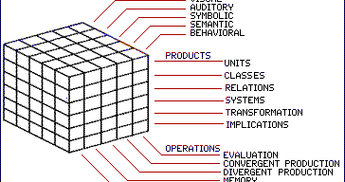
Thorndike’s Multifactor Theory of Intelligence:
Proposed by EL Thorndike. According to Thorndike, intelligence is not a single factor like general intelligence rather it is a combination of multiple factors. These factors include: (a) Abstract intelligence, (b) Concrete (technical) intelligence, (c) Social intelligence, etc.
According to Thorndike, the common element does not exist in the
Individual but in the nature of the tasks themselves.
Level of difficulty they can manage. They also differ in the range or number of tasks they can or cannot perform. Thorndike believed intelligence was like
A series of skills or talents. It is several or many tasks that might call for the same kind of ability. According to him, the correlations between various tests
Are the result of the fact.

Slide 17
Categories in Guilford’s Structure of Intellect theory
Guilford’s “Structure of Intellect” approach categorizes and organizes the
varied talents into three Categories: content, product, and process, respectively.
Each dimension is briefly described in the next section.
Operations Dimension
The structure of intellect consists of six operations or general intellectual
Processes:
2. Cognition
Cognition includes aspects like understanding, comprehending, discovering
and becoming aware of the information.
3. Memory Recording
Memory recording is the proficiency to integrate and encode information.
4. Memory Retention
Memory retention is the ability to recollect facts or information.
5. Divergent Production
Divergent production describe the ability to develop different ways to solve
problems, it also refers to the ability to be creative.

Slide 18
6. Convergent production
Convergent production is the capacity to derive singular answers to problems from a set of rules, It is also known as rule-following or problem-solving.
7. Evaluation
Evaluation is the ability to determine whether a piece of particular information is correct, reliable or trustworthy.
Gardner’s Multiple of Intelligence:
The human ability to solve problems or to make something that is valued in one or more cultures.
The theory of multiple intelligence was first proposed by Howard Gardner in his 1983 book
“Frames of Mind”, where he broadens the definition of intelligence and outlines several distinct types of intellectual competencies.
Gardner defines intelligence as a “bio-psychological potential information that can be activated in a cultural setting to solve problems or create products that are of value in a culture”.
Many of us are familiar with three broad categories in which people learn: visual learning, auditory learning, and kinesthetic learning. Beyond these three categories, many theories of and approaches toward human learning potential have been established.

Slide 19
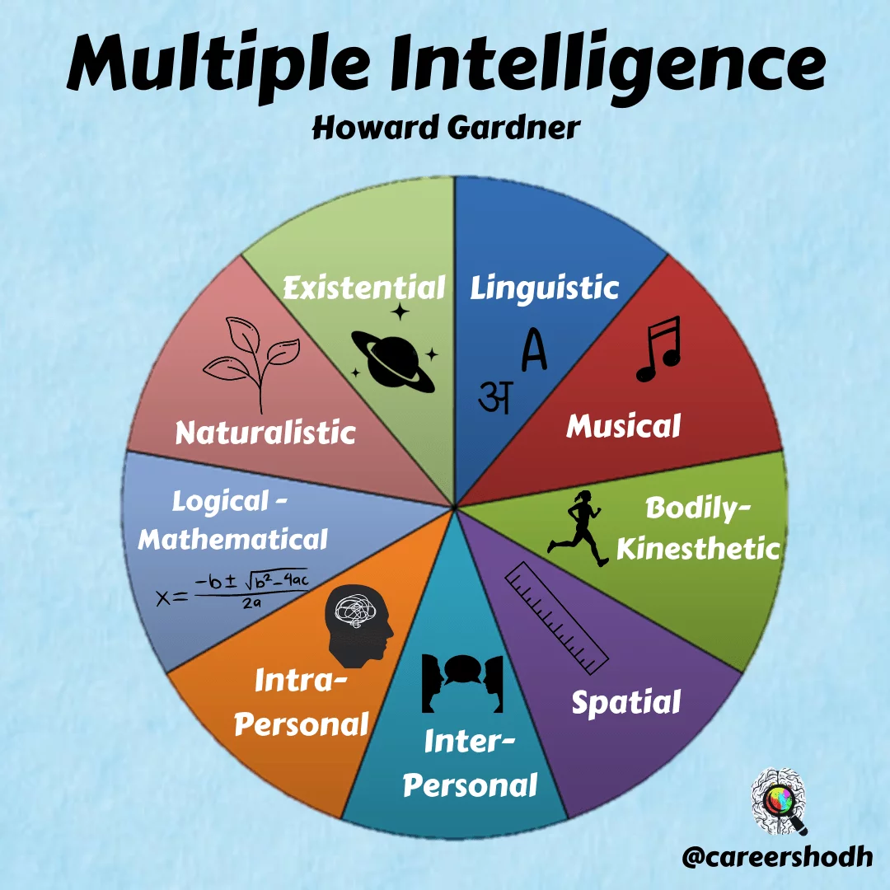
The theory of multiple intelligence is Howard Gardner’s theor
that proposes:
That people are not born with all of the intelligence they will
ever have.
It says that intelligence can be learned throughout life.
Claims that everyone is intelligent in at least nine different ways and
can develop each aspect of intelligence to an average level of
competency.
Intelligence, as defined by Gardner, is the ability to solve problems or
fashion products that are valuable in one or more cultural settings.
The 9 intelligences included in Gardner’s theory are:
Verbal/Linguistic
Visual/Spatial
Interpersonal
Musical/Rhythmic
Logical/Mathematical
Intrapersonal
Bodily/Kinesthetic
Naturalist
Existentialist

Slide 20
Intelligence Quotient(IQ):
intelligence quotient, is a measure of your ability to reason and solve problems. It reflects how well you did on a specific test compared to other people of your age group. A low IQ score is anything 70 and below. A low score and other indicators might suggest that a person has an intellectual disability.
IQ is a type of standard score that indicates how far above, or how far below, his/her peer group an individual stands in mental ability. The peer group score is an IQ of 100, this is obtained by applying the same test to huge numbers of people from all socio-economic strata of society, and taking the average.
The term IQ was coined in 1912 by the psychologist William Stern in relation to the German term Intelligenz quotient. At that time, IQ was represented as a ratio of mental age to chronological agex100.
When current IQ tests were developed, the average score of the norming sample was defined as IQ 100, and standard deviation up or down was defined as, for example, 16 or 24 IQ points greater or less than 100.

Slide 21
Assessment of Intelligence:
Intelligence tests and other aptitude tests are designed to measure cognitive skills, abilities, and knowledge that are accumulated as the result of overall life experiences including those a school, home, work and all other settings. As a result, general intelligence tests are not linked to a specific academic curriculum or Knowledge domain and so are much broader in scope than achievement tests. General intelligence tests assess abilities such as problem-solving, abstract reasoning, and the ability to acquire knowledge.
Intelligence is among the oldest and longest studied topics in all of psychology. The development of assessments to measure this concept is at the core of the development of
Psychological science itself. This module introduces key historical figures, major theories of intelligence, and common assessment strategies related to intelligence. This module will also discuss controversies related to the study of group differences in intelligence.
Learning Objectives:
List at least two common strategies for measuring intelligence.
Name at least one-type of intelligence.
Define intelligence in simple terms.
Explain the controversy relating to differences in intelligence between groups.

Slide 22
Intelligence Assessment:
The measurement of intelligence is typically done through intelligence tests, which are designed to assess an individual's cognitive abilities. These tests are often standardized, meaning they are administered, scored, and interpreted similarly for all test-takers.
An individually administered test used to determine a person's level of intelligence by measuring his or her ability to solve problems, form concepts, reason, acquire detail, and perform other intellectual tasks.
An early scholar of intelligence, Charles Spearman, proposed the idea that intelligence was one thing, a “general factor” sometimes known as simply “g”. He based this conclusion on the observation that people who perform well in one intellectual area such as verbal ability also tend to perform well in other areas such as logic and reasoning.
Galton was particularly interested in intelligence, which he thought was heritable in much the same way that height and eye colour are. He conceived of several rudimentary methods for assessing whether his hypothesis was true.
Although his methods were crude by modern standards, Galton established intelligence as a variable that could be measured.

Slide 23
Creativity:
Creativity assessment is as old as the concept itself. Researchers from various cultures and disciplines attempted to define the concept of creativity and offer a valid way to assess it.
Creativity is generally defined as the ability to produce work that is novel and appropriate. Researchers in the field attempted to measure creativity from different perspectives and tried to answer the question like “What are the mental processes involved in creative thought?, Which personality traits are associated with creativity?, How can a product can be judged to be creative? And, What are the external forces that affect creativity?”. The answers of these questions constitute the most commonly used creativity assessment instruments.
Introduction:
Researchers from various cultures and disciplines attempted to define creativity and offer a valid way to assess it. As creativity is a multifaceted phenomenon, it is a complicated task to
Define and operationalize it. The usefulness of higher order cognitive constructs is related to their definitions’ degree of clarity. Creativity has become one of the most popular skills that schools and organizations search for. As of now supporting creativity is the common goal of a kindergarten, a research institute or the biggest corporations in the world. The importance of creativity is anticipated to increase in the future due to various societal and economic trends as explained.

Slide 24
Concept, Factors and of Process:
The Process of Factors
A process is more than the program code, which is sometimes known as the text section. It also includes the current activity as represented by the value of the program counter and the contents of the processor’s registers.
A process generally also includes the process stack, which contains temporary data, and a data section, which contains global variables.
A program becomes a process when an executable file is loaded into memory. Two common techniques for loading executable files are double-clicking an icon representing the executable file and entering the name of the executable file on the command line. It is also common to have a process that spawns many processes as it runs.
Genetic Factors
Our genes do influence intelligence and IQ. Different studies have placed the genetic component at different studies have placed the genetic component at different levels ranging from 30-80%, but it is agreed that the level of genetic influence increases with age, at least from childhood through to early adulthood. Studies also agree that the proportion of the variability of IQ between adult individuals that can be accounted for by genes is 60-80%. Autism is also correlated with brain size in ways that are likely controlled by genes,

Slide 25
Although there are of course disturbed neuronal pathways in autism.
Environmental Factors:
We may be genetically predisposed to a certain brain volume, structure and pathways —
a certain level of intelligence set by our biology– but how much we achieve isn’t based in
Biology alone. The type of life we lead also affects intelligence.
Genetic effects cause bright children to seek out more stimulating environments that
Further increase IQ. Programs aiming to increase IQ would be most likely to produce long-term
IQ gains if they caused children to persist in seeking out cognitively demanding experiences.
Several factors can lead to significant cognitive impairment, particularly if they occur during
Pregnancy and childhood when the brain is growing and the blood brain barrier is less
Effective. It includes pollutants, alcohol, smoking and drugs, head injuries and mental illnesses
Can also cause cognitive impairment.
Strategies for fostering Creativity:
Creativity is considered a skill that everyone is expected to possess, which leads to the question: is creativity innate or fostered? As children, we approach life with an untamed imagination, where “colouring Within the lines “ is a mere suggestion.

Slide 26
Quickly, however, imagination becomes hindered by life’s rules and regulations. Therefore, it is
Reasonable to assume that each individual is born with some level of creativity, and by nurturing and developing this attribute, it can resurface and grow.
Each element of the framework interacts with and affects another element. In sum,
The four Ps refer to creativity as a process that is influenced by personal and press creativity to generate creativity to generate creative output.
Although there are four components of the framework, this article will focus on the
Components that can be learned: process and press. We will introduce strategies to improve the creative process and creative press. To demonstrate the implementation of these strategies, we will include examples from the Michigan Center for Hand Outcomes and Innovation Research group, the research arm of Michigan Medicine’s Comprehensive Hand
Center. This group is made up of a variety of individuals, from undergraduates to senior surgeons, and is a good candidate to illustrate how strategies for increasing creativity can be
Applied across different training levels.
Strategies for Fostering Creativity:
Many strategies exist to foster creativity and fortunately, many of the strategies that will be presented here are already being applied unknowingly, but it is helpful to articulate what is being observed and Practiced.

Slide 27

Model Questions
What is Meaning and Definition of Intelligence and write types
Describe the Theories of Intelligence?
Two Factor Theory
Thurston’s Group Factor
Thorndike’s Multi factor
Quilford Structure of Intellect
Gardner’s Multiple Intelligence
3. What are the intelligence Quotient?
4. Write the Notes on Assessment of Intelligence?
5. What is Concept of Creativity and Process of Creativity?
6. How is Strategies for Fostering Creativity?

Slide 28


