Slide 1
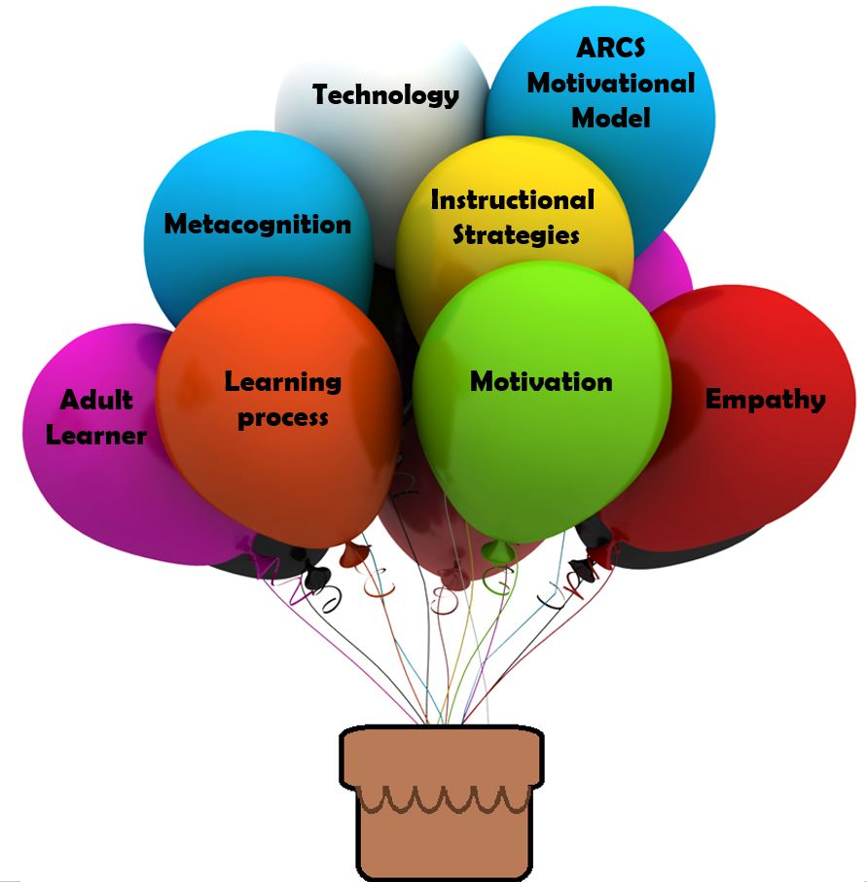
MOTIVATION AND LEARNING
UNIT-III

Slide 2

Meaning of motivation
Definition of motivation
Maslow’s theory of motivation and its educational implications
Level of Aspiration
Learning
Cognitive Theory-Jean Piajet
Behaviourist Theory
Ivan Pavlov and His Dogs
Skinner’s Operant Conditioning and Thorndike Connectionism
Constructivist theory-John Dewey
Humanistic Theory
Carl Rogers Humanistic Theory

Slide 3
Meaning of motivation
Motivation is an important factor which encourages persons to give their best performance and help in reaching enterprise goals. A strong positive motivation will enable the increased output of employees but a negative motivation will reduce their performance, A key element in personnel Management is motivation.
Definition of motivation
Motivation can be defined as stimulating, inspiring and inducing the employees to perform to their best capacity. Motivation is a psychological term which means it cannot be forced on employees. It comes automatically from inside the employees as it is the willingness to do the work.
Maslow’s theory of motivation and its educational implications
Abraham Maslow is well renowned for proposing the Hierarchy of Needs Theory in 1943. This theory Is a classical depiction of human motivation. This theory is based on the assumption that there is a hierarchy of five needs within each individual. The urgency of these needs varies. These five needs are as follows:

Slide 4
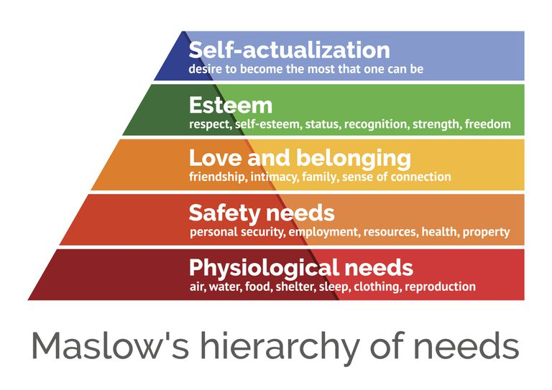

Slide 5
1. Physiological Needs
These are the basic needs of air, water, food, clothing and shelter. In other words
, physiological needs are the needs for basic amenities of life.
2 . Safety Needs
Safety needs include physical, environmental and emotional safety and protection. For
Instead- Job security, financial security, protection. For animals , family security, health
Security , etc.
3 . Social Needs
Social needs include the need for love, affection , care , belongingness , and friendship.
4 . Esteem Needs
Esteem needs are of two types: internal esteem needs ( self - respect , confidence ,
Competence , achievement and freedom ) and external esteem needs (recognition , power ,Status attention and admiration ) .

Slide 6
5 . Self – actualization Need
This include he urge to become what you are capable of becoming / what you have the
Potential to become . It includes the need for growth and self – contentment . It also
Includes desire for gaining more knowledge , social - service creativity and being aesthetic.
Implications of Maslow’s Hierarchy of Needs theory for Managers
I . As far as the physiological needs are concerned the managers should give
Employees appropriate salaries to purchase the basic necessities of life.
II . As far as the safety needs are concerned, the managers should provide the
Employees job security, safe and hygienic work environment, and retirement
Benefits so as to retain them.
III . As far as social needs are concerned, the management should encourage
Teamwork and organize social events.
IV. As far as esteem needs are concerned, the managers can appreciate and reward employees on accomplishing and exceeding their targets.
v. As far as self-actualization needs are concerned, the managers can give the employees challenging jobs in which the employees’ skills and competencies are fully utilized.

Slide 7
Limitations of Maslow’s Theory
i. It is essential to note that not all employees are governed by same set of needs. Different
Individuals may be driven by different needs at same point of time.
ii. The theory is not empirically supported.
iii. The theory is not applicable in case of starving artist as even if the artist’s basic needs are not Satisfied, he will still strive for recognition and achievement.
Level of Aspiration
Level of aspiration refers to where and how far individuals set their targets for achievement.
It is a complex phenomenon and is determined largely by our past failures and success, perceptions about our own ability and some elements of involvement of our ego and self.
In setting our level of aspiration whether it is high or low, what we attribute our failure or Success to become very important considerations. The failure or success may be attributed to ability effort, mood, luck, knowledge, unfairness, interest of others etc.
The significant point is that how the individual analyses and explains his success or failure Will determine what targets he sets for him/ herself as future aspirations.

Slide 8
Learning
Theories of experiential learning assume that an adaptive process replicates success. In this article we outline the importance of studying an interaction between learning and aspiration levels and briefly examine the role of aspirations in risk taking and decision-making contexts, and the issue of historically and socially formed adaptive aspirations.
Theories of Learning and its Educational Implications
Learning Theories
Learning as a process focuses on what happens when the learning takes place. Explanations of what happens constitute learning theories. A learning theory is an attempt to describe how people and animals Learn, thereby helping us understands the inherently complex process of learning.
Learning theories have two chief values according to Hill(2002). One is in providing us with vocabulary and a conceptual framework for interpreting the examples of learning that we observe. The other is in suggesting where to look for solutions to practical problems. The theories do not give us solutions but they do direct our attention to those variables that are crucial in finding solutions.

Slide 9
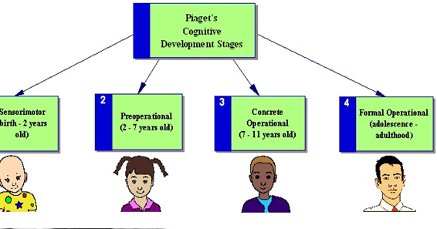
Cognitive Theory-Jean Piajet
Jean Piaget’s theory of cognitive development suggests that intelligence changes as children grow.
A child’s cognitive development is not just about acquiring knowledge, the child has to develop or Construct a mental model of the world.
Cognitive development occurs through the interaction of innate capacities and environmental events, and children pass through a series of stages. Piaget’s theory of cognitive development proposes 4 stages of development.

Slide 10
How Piajet developed the theory
Piaget was employed at the Binet institute in the 1920’s, where his job was to develop French
Versions of questions on English intelligence tests. He became intrigued with the reasons
Children gave for their wrong answers to the questions that required logical thinking.
Piaget branched out on his own with a new set of assumptions about children’s intelligence:
1. Children’s intelligence differs from an adult’s in quality rather than in quantity.
2. Children actively build up their knowledge about the world.
3. The best way to understand children’s reasoning was to see things from their point of view.

Slide 11
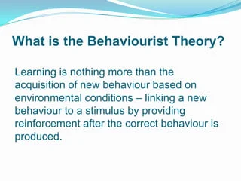
Piaget’s four stages
Stage | Age | Goal
Sensorimotor | Birth to 18-24 months | Object permanence
Preoperational | 2 to 7 years old | Symbolic thought
Concrete operational | Ages 7 to 11 years | Logical thought
Formal Operational
Adolescence to adulthood
Scientific reasoning
Behaviourist Theory

Slide 12
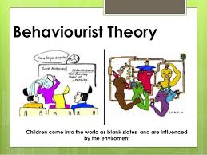
Behaviorism focuses on the idea that all behaviors are learned through interaction with the environment. This learning theory states that behaviors are learned from the environment, and says that innate or inherited factors have very little influence on behavior.
Students are a passive participant in behavioural learning teachers are giving them the information as an element of stimulus-response.
Teachers use behaviourism to show students how they should react and respond to certain stimuli.
This needs to be done in a repetitive way, to regularly remind students what behavior a teacher is looking for.

Slide 13
Teachers can implement behavioural learning strategy techniques in their classroom
in many ways Including:
1. Drills( teachers practice skills using drill patterns)
2. Question & answers( Teachers can use a question as a stimulus & answer as a response)
3. Guided practice(Teacher‘s can be directly involved in helping students go through problems)
4. Regular review. (Review are important to behavioral learning theory)
5. Positive reinforcement. (Behaviorist classrooms utilize positive reinforcement regularly)
6. Behaviorist is best for certain learning outcomes like foreign languages and math etc.
7. The theory doesn’t encompass enough of human learning and behavior, and that it’s not fully developed.
8. It’s important to get the right degree and credentials to help you be prepared for success.

Slide 14
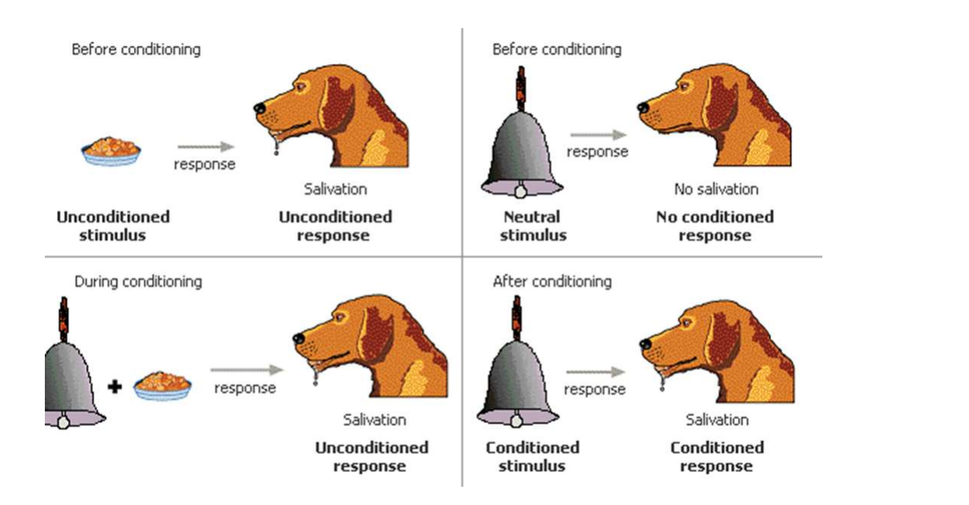
Ivan Pavlov and His Dogs
Pavlov had the idea that dogs do not need to learn certain things, such as salivating when they see food. He said these reflexes are hard-wired into dogs. He coined the dog's food as an unconditioned stimulus and the salivation as an unconditioned response - this response did not require any learning on the dog's part.
Classical Conditioning
The people who fed pavlov’s dogs wore lab coats. Pavlov noticed that the dogs began to drool whenever they saw lab coats, even if there was no food in sight. Pavlov wondered why the dogs salivated at lab coats, and not just at food. He ran a study in which he rang a bell every time he fed the dogs. Pretty soon, just ringing a bell made the dogs salivate.

Slide 15
Pavlov’s Classical Conditioning (1849-1936)
First discovered by Russian physiologist Ivan Pavlov (1849-1936), classical conditioning is a learning process governed by associations between an environmental stimulus and another stimulus which occurs naturally. All classical conditioned learning involves environmental interaction.
In these experiments, Pavlov trained his dogs to salivate when they heard a bell ring. In
Order to do this he first showed them food, the sight of which caused them to salivate.
Basic Concepts in Classical Conditioning
Stimulus generalization
(This is when individuals respond in the same way to experienced stimuli)
Stimulus discrimination
(Organisms can learn to discriminate between various stimuli)
Higher order conditioning
(This is when a neutral stimulus can cause the conditioned response sense if it had been associated with the conditioned stimulus.

Slide 16
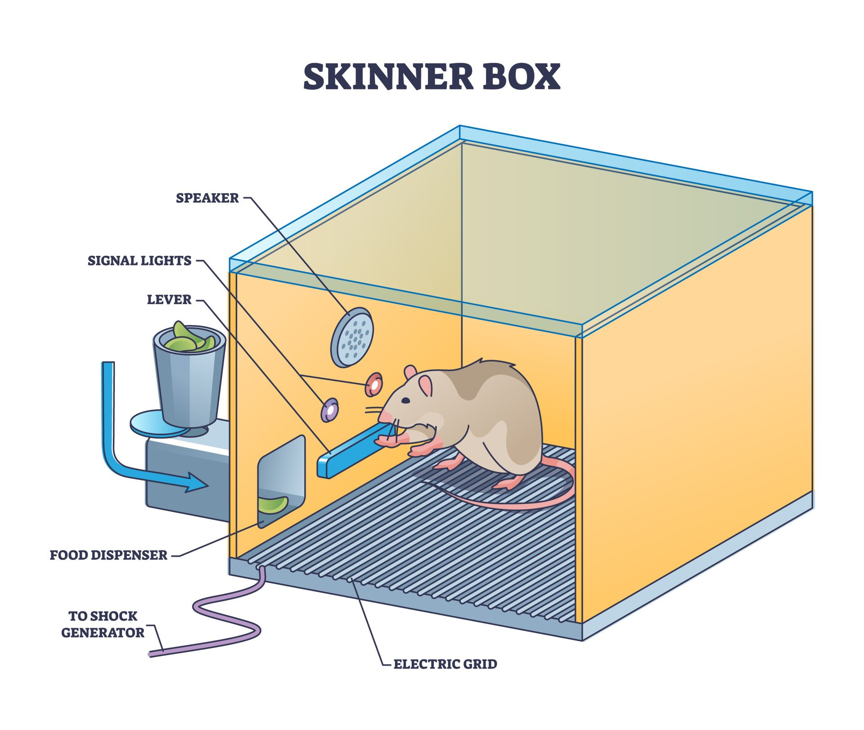
Skinner’s Operant Conditioning and Thorndike Connectionism
In operant conditioning, behaviors are manipulated when either positive
Or negative reinforcement follows them. Positive reinforcement
Increases desired behaviors by following them with rewards.
For example , if rat food dispensed every time a rat pushes a pedal, it
Will repeatedly push that same pedal to get more edible treats . The
Action of pushing the pedal , the desired behavior , has been
Reinforcement with food .
Negative reinforcement increase desired behaviors by allowing
Subjects to escape punishment through their performance . For example
If a rat received a painful electrical jolt that would not cease unless
It pressed a pedal , it would begin to press it quickly following each
Initial jolt to relieve its pain . The action of pushing the pedal , the
Desired behavior , has again been reinforcement though by a different method
than before.
The theory of B.F Skinner is based upon the idea that learning is a function of change behavior.
Change in behavior are the result of an individual’s response to events (Stimuli) that occur in
the environment.
Skinner’s theory is that it attempted to provide behavioral explanations for a broad range of
Cognitive phenomena. For example, Skinner explained drive (motivation) in terms of
deprivation and reinforcement

Slide 17
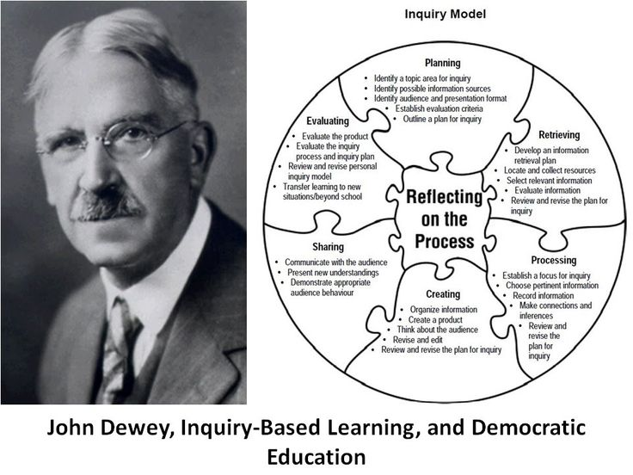
Constructivist theory-John Dewey
One of the key figures in the development of constructivism is John Dewey, who believed that education should be centered around the learner and their experiences. Dewey believed that learning should be interactive and that students should be encouraged to explore and discover new information on their own.

Slide 18
Dewey emphasizes inquiry and the integration of real world and classroom activities. The constructivist framework relies on the learners to be in control of their own acquisition of knowledge and encourages the instructor to serve as a facilitator.
Both Dewey and Vygotsky(whose work he never read). Both Dewey and Vygotsky emphasized the role of cultural forms and meanings in perpetuating higher forms of human
Thought, whereas Piaget focused on the role played by logical and mathematical reasoning.
On the other hand, with Piaget, Dewey emphasized the nurture of independence reasoning central to the liberal protestant heritage the two men shared. Indeed, Dewey’s broad theorizing of democracy’s implications for schooling can be seen to integrate the research emphases of the two psychologists.
His research insists that learners need to connect real life experiences with school activities in order to make learning possible.
Humanistic Theory
The humanistic theory in education. In history humanistic psychology is an outlook or system of thought that focuses on human beings rather than supernatural or divine insight. This system stresses that human beings are inherently good, and that basic needs are vital to human behaviors. The Humanistic approach develop in the 1960’s as a critical reaction to the technical emphases of both psychodynamic and behaviorist learning approaches to psychology.

Slide 19
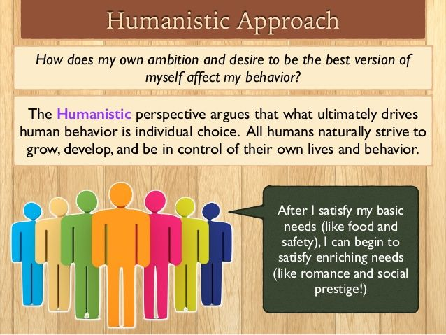
There are a whole range of conditions that must be met before any person can work on becoming self
-actualized , according to the “ needs hierarchy “ describe by Abraham Maslow , people must
First secure their basic “organismic” needs (including adequate food, clothing and shelter
Necessary to keep themselves alive). Having achieved the basics, they next worry about
And work to achieve: a feeling of adequate safety , a sense of belonging (to one or more social
Groups and relationship ) sense of self – respect . Self- actualization , the drive to do all that
You desire to do with your life , is something that only emerges as a motivator of behavior
After all the earlier needs are adequately satisfied.

Slide 20
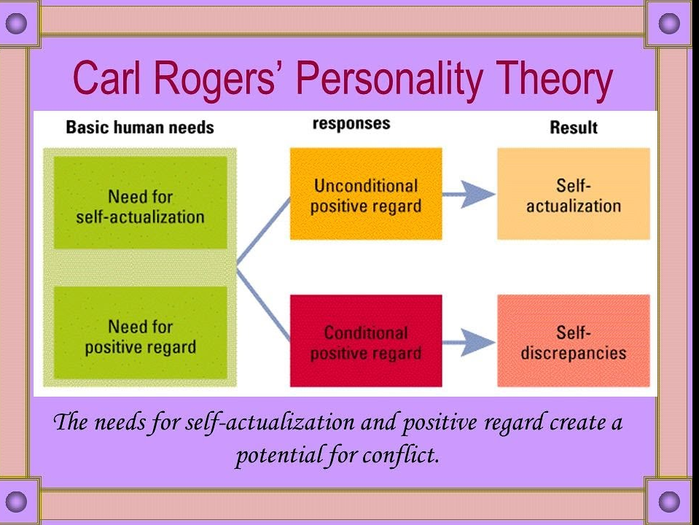
The humanistic learning theory developed further and harnesses the idea that if students are upset
Sad, or distressed , they’re less likely to be to focus on learning. This encourages teachers to create
a classroom environment that helps students feel comfortable and safe so they can focus on their
Learning. Emotions are at the center of humanism psychology.
Carl Rogers Humanistic Theory

Slide 21
Carl Rogers believed that for a person to achieve self-actualization, they must be in a state of congruence. According to Rogers, we want to feel, experience, and behave in ways which are consistent with our self-image and which reflect what we would like to be like, our ideal-self.
Carl Rogers(1902-1987) was a humanistic psychologist who agreed with the main assumptions of Abraham Maslow. However, Rogers(1959)added that for a person to “grow”,
They an environment that provides them with genuineness, acceptance, and empathy. Without these, relationships and healthy personalities will not develop as they should, much
Like a tree will not grow without sunlight and water.
Carl Rogers is known as one of the best humanistic psychologists and psychotherapists of his time. At the beginning of his career, he worked with children, and later as he started working with adults and teaching, his mastery of the therapeutic approach became well-known.
Carl Roger’s theory is looked at as phenomenological, existential, and humanistic. His theory is directly related to phenomenal field personality theory by Combs and Snygg that was introduced in the year 1949.
Carl Rogers took this theory as a base and elaborated it extensively with his perceptions.
There are sixteen Carl Rogers’s books and innumerable journal articles on his theories.
He has encouraged a humanistic approach to conducting therapy and a scientific approach to evaluate therapy needs.

Slide 22

Model Questions
What is meaning and definition of motivation?
Describe the Maslow theory of Motivation and it’s educational implications?
Write the notes on level of Aspiration.
Write brief notes on:
a) Jean Piajet in Conductive Theory
b) Pavlov’s classical conditioning
c) Skinner”s Operant conditioning
d) Thorndike connectionism theory
e) John Dewey constructivise theory
f) Carl Rogers Humanistic theory

Slide 23


