Slide 1

EDUCATIONAL PSYCHOLOGY

Slide 2
UNIT:1
EDUCATIONAL PSYCHOLOGY AND HUMAN GROWTH AND DEVELOPMENT
Meaning of psychology
Definitions of psychology
Educational psychology
Meaning of educational psychology
Scope of educational psychology
Significance of educational psychology
Dimensions of human growth and development

Slide 3
Infancy stage
Early childhood development
Later childhood development
Phases of developmental and development tasks

Slide 4
Meaning of psychology
The word, ‘Psychology’ is derived from two Greek words, ‘Psyche’ and ‘Logos’. Psyche
means ‘soul’ and ‘Logos’ means ‘science’. Thus psychology was first defined as the ‘science
of soul”. It was called rational psychology.
But modern psychology is empirical, and does not deal with the problems relating to the soul.
It deals with mental process apart from the soul or mental substances.
It is the science of experience and behavior, which tells us how the mind works and behaves.
Psychology is concerned with the experience and behavior of the individual.

Slide 5
Definitions of psychology
Etymologically, the word "Psychology" derives its meaning from the two Greek words 'psyche' which means 'soul' and 'logus' which means 'science' or 'knowledge'. Thus 'Psychology' literally means the science of the soul. This definition of 'Psychology' has been given up long ago.
Today Psychology is defined as the science of behaviour, the way human beings behave and the reasons for their behaviour. The term behaviour should be understood in a broad manner, to refer not only to observable overt bodily activities (which alone should be the subject matter of psychological investigations as per behaviourism) but also covert and inferred behaviour which could be designated as mental or conscious activity. As such psychology is now defined as "a science that systematically studies and attempts to explain observable behaviour and its relationship to unseen 'mental' processes (experiences) that go on inside the organism and to external events in the environment".

Slide 6
". The goals of psychology are description, explanation, prediction and control of behaviour including subjective experiences”.
In 1892 William James defined psychology as the science of mental processes, In his view, psychology may be defined in terms of conscious states.
In 1884 James Sully defines psychology as the science of the inner world, as distinguished from physical science which study the physical phenomena.
In 1905 William McDougall defines psychology as the science of behavior,
J.B.Watson, states the psychology as a science studies the response pattern of an individual in reaction to the stimuli coming from the environment.
K.Koffka states that the main aim of psychology is the study of behavior.
R.S.Woodworth defines psychology as the “science of activities of the individual”

Slide 7
Educational psychology
Educational psychology is defined as that branch of psychology which is concerned with psychological researches as applied to any or all aspects of educational processes and practices. It is in relation to problems like learning, teaching and training. Classroom is the laboratory for the educational psychologists.
By applying the principles and laws of psychology in educational situations, educational psychology tries to solve the different problems faced in the educative process so as to make it more effective and efficient.

Slide 8
Psychology is the science of behaviour. Education is the deliberate process of modifying one's behaviour (knowledge, skills and attitude) through a sequence of
systematically planned experiences to achieve the
predetermined goals and objectives (Redden). Therefore !
educational psychology could be considered as the science of modifying the learner's behaviour so as to
refine his personality and make him an efficient and responsible citizen.

Slide 9
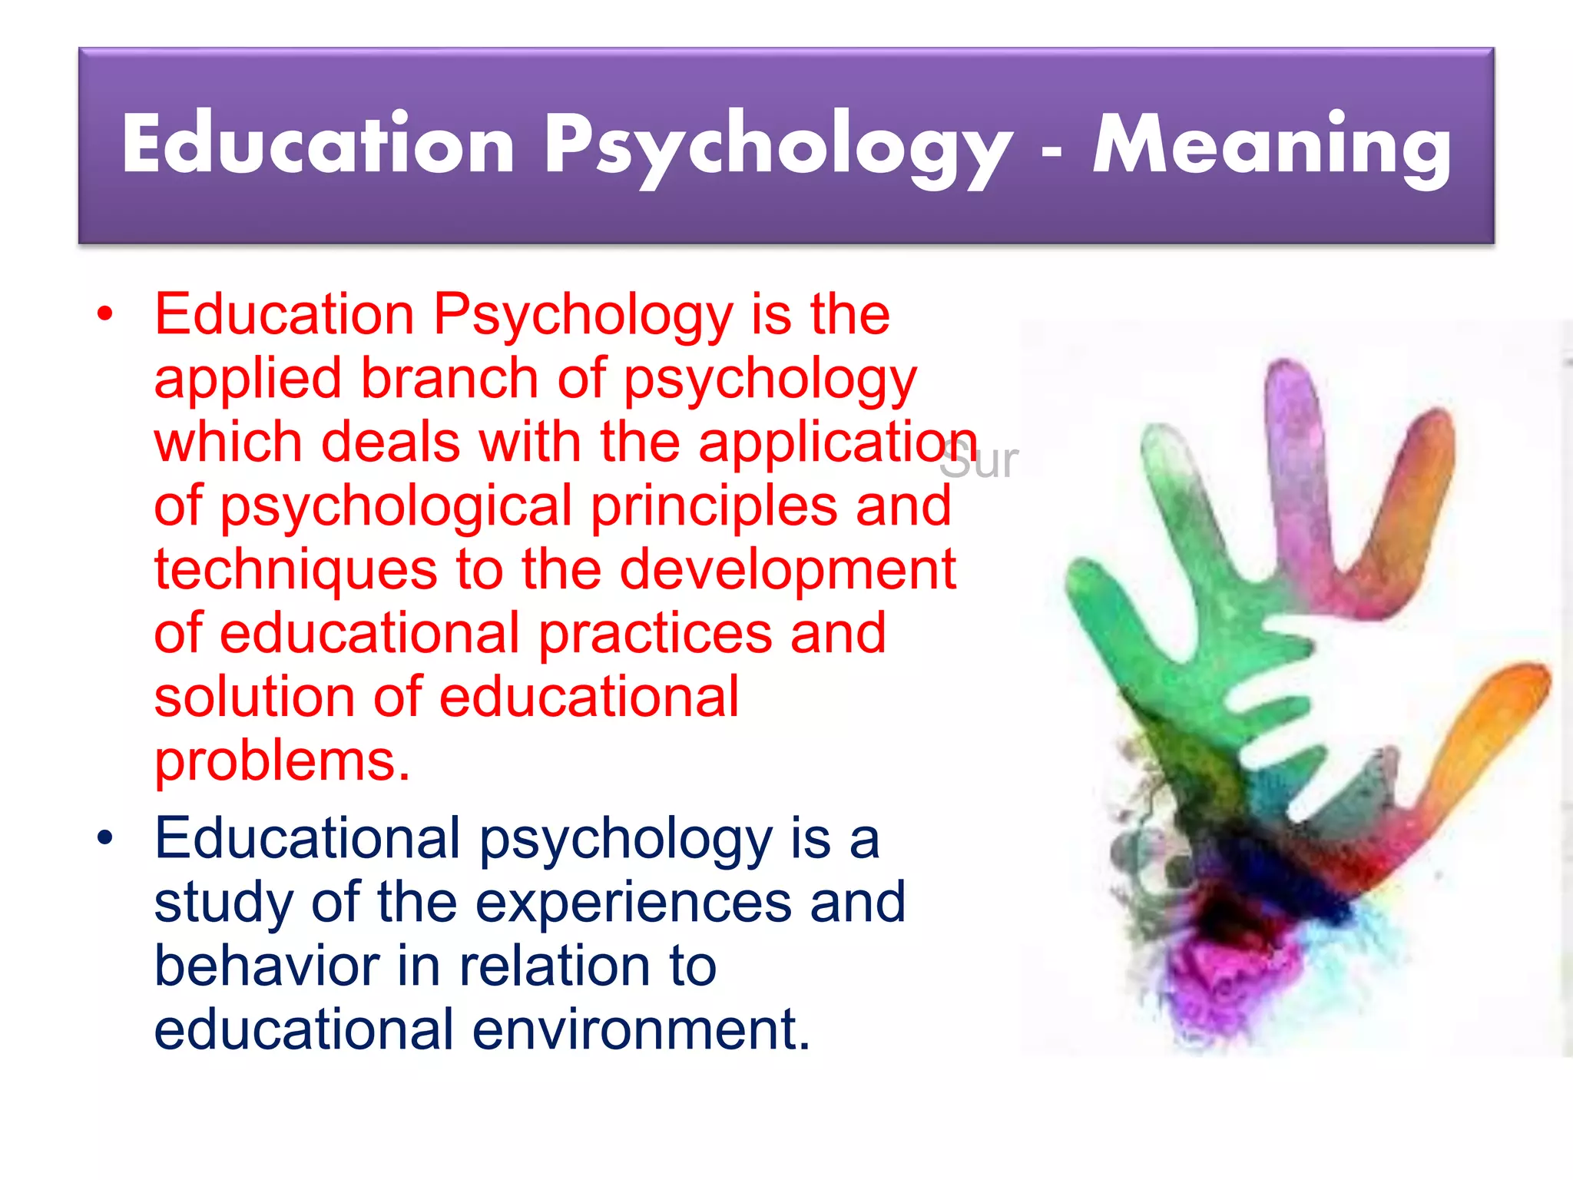
Meaning of Educational psychology

Slide 10
Scope of Educational psychology
It includes the following aspects:
Human Behaviour
It studies human behavior in the educational context. Psychology is the study of behavior and education aims at modification of behavior. Hence the influence of Educational Psychology has to be reflected in all aspects of education.
2. Growth and development
It studies the principal governing growth and development. The insight provided by the study will help in scientifically planning and executing learner oriented programmes of education.
3. The Learner
The subject-matter of educational psychology is knitted around the learner. Therefore, the need of knowing the learner and the techniques of knowing him well.
The topics include-the innate abilities and capacities of the individuals, individuals difference and their measurements and so on…..
4. The Learner experience
Educational Psychology helps in deciding what learning experiences are desirable, at what stage of the growth and development of the learner etc.

Slide 11
5. Learning Process
Educational psychology moves on to the laws, principal and theories of
Learning.
6. Learning Situation or Environment
Here we deal with the environmental factors and learning situations which come midway
Between the learner and the teacher.(like classroom climate and group dynamics, techniques and aids that facilitates leaning and evaluation, techniques and practices, guidance and Counselling etc.
7. Evaluation of learning process
Educational psychology guides are by explaining the different methods of assessment
Contributing to the effectiveness of learning process.
8. Individual differences
It is universally accepted that every individual differs from every other individual. This idea has been brought to light by educational psychology.

Slide 12
9. Personality and adjustment
Education has been defined as the all-round development of the personality of an individual. If educational has to fulfill this function all instructional programmes have to be based on the Principles governing the nature and development of personality.
10. The Teacher
The teacher plays an lead role in any scheme of teaching and learning process. It discusses the role of the teacher, it emphasizes the need of “knowing thyself” for a teacher to play his role properly in the process of education.
11. Guidance and Counseling
Education is nothing by providing guidance and counseling for the proper development of the child.
Educational psychology has come to the rescue by developing principles and practical measures helpful for providing effective guidance and counseling. We can conclude by saying that educational counseling is narrower in scope than general psychology. It is concerned with the behavior of the leaner in an educational setting.

Slide 13
Significance of Educational psychology
1. Catering to individual differences
No two persons are exactly alike. Pupils differ in their level of intelligence, aptitudes, likes and dislikes
and in other propensities and potentialities. There are gifted, backward, physically and mentally
challenged children. Thus, psychology tells the teacher about the individual differences among the
students in the class and the procedure, methodology and techniques to be adopted for them.
2. Understanding the learner
The child or the learner is the key factor in the teaching-learning process. Educational psychology helps the teacher to know his interests, attitudes, aptitudes and the other acquired or innate capacities and abilities; to know the stage of development linked with his social, emotional, intellectual, physical and aesthetic needs; to know his level of aspiration, his conscious and unconscious behaviour; his motivational and group behaviour; his conflicts, desires and other aspects of his mental health.
3. Understanding development characteristics
To be a successful doctor, one must have the required professional knowledge and skills as well as the knowledge about the nature of the patient whom he wants to treat. In the same way, if one wants to be a successful teacher, he must know about the science of behaviour of learners.

Slide 14
4. Understanding group dynamics
The teacher must know the operations of group dynamics in classroom teaching-learning as well as
Total school and social environment and their effect on learning.
5. Understanding the nature of classroom learning
Educational Psychology helps the teacher to adapt and adjust his teaching according to the level
of the learners.
6. Understanding effective methods of teaching
Educational Psychology has discovered several new approaches, principles. methods and techniques
of teaching which are very helpful in today’s teaching-learning process.
7. Curriculum construction
Curriculum is an integral part of the teaching-learning process. Curriculum should be child-centred
and fulfil the motives and psychological needs of the individual because child capacities differ from
stage to stage.
8. Measurement of learning outcome
Psychological tools help the teacher to assess the learning outcome of the students. He can also evaluate his teaching methods and in the light of the performance of his students can modify his strategy of teaching.

Slide 15
9. Understanding the learning process
All education depends upon the learning of new responses and the capacity of a human
child to learn new responses.
10. Knowledge of mental health
Educational Psychology helps the teacher to know what are the factors responsible for the mental
ill-health and maladjustment of a student and to suggest improvement thereof. it also provides the
teacher with necessary insight to improve his own mental status to cope up with the situation.
11.Developing scientific attitude
Knowledge of educational psychology is helpful in making the teacher more scientific in his
educational practices.
12.Educational psychology and nervous system
The entire education depends on the functions of the brain ad nervous system.
13. Educational psychology and play
Play is a natural tendency having great educational potentials.
14. Educational psychology and productive activities
Educational psychology helps the teacher to know how various activities in these fields can be
used for the fulfilment of the basic needs of children.

Slide 16
15.Understanding the significance of research
Educational psychologists conduct research to improve the behaviour of human beings in the
educational situation.
16. Guidance for the education of the exceptional children
Educational psychology has contributed a lot for making specific provision and organization of
Educational programs for the exceptional children who remained neglected in the past, were devoid of
Suitable educational facilities.
17. Character development
Educational psychology helps a lot to the formation and development of character.
18.Constructive and creative discipline
Now teachers adopt a cooperative and scientific approach to modify the behavior of the student.
Emphasis is held on self-discipline through creative and constructive activities.
19.Use of audio-visual aids or new instructional technology
It has been experimentally proved that the use of audio-visual aids holds the attention and interest
of the children for a longer period and makes the difficult concepts more clear and learning becomes
More lasting.
20. Time-table framing
Now subjects are incorporated in the time-table taking into consideration their difficulty level and fatigue
index. No two difficult subjects are taught in successive periods.

Slide 17
21. Provision for co-curricular activities
Teachers used to give undue importance to the theoretical subjects in schools. Activities like debate,
drama, scouting and games were supposed to be a wastage of time. Now we give these activities
due importance for the harmonious development of the personality of children.
22. Use of innovation and projects
Several innovative ideas resulting from research studies in psychology have been introduced to improve
the teaching-learning process. Activity-centred teaching, discussion method, micro-teaching,
programmed instruction etc.
23. Production of suitable textbooks
We now write text books taking into consideration the intellectual development of children, their needs
and their interests at different age levels.
24. Democratic administration and management
Democratic practices in functioning of educational institution are taking the place of autocratic
Practice. Teachers and students are associates in several areas of school administration.
25. Educational psychology and the parents
An elementary knowledge of educational psychology is very essential for parents also. After all children
Spend a good deal of their time in the home. Parents are their first teachers. Educational psychology is
Very helpful to the parents to understand the growth and development of the child, their emotional
Mental and physical needs etc.

Slide 18
Dimensions of human growth and
development
The dimensions of human development are divided in to separate, consecutive stages of life from birth to old age:
1. Stages of human developments
1. Prenatal development
2. toddler
3. Early childhood
4. Late childhood
From fertilization until birth
Babies between the ages of 1 & 2
Ages of 3 to 4yrs
Attend preschool & engage in activities
Intelligence is demonstrated through logical and systematic manipulation.

Slide 19
5. Adolescence
6. Early adulthood
7. Middle adulthood
8. Old age
Onset of puberty and the full commitment to an adult social role
Person must learn how to form intimate relationship
Period between ages 40 to 60
Period over 60-80 years(final stage)
2. Physical development and growth
Differences in physical growth are apparent from everyday observation of people around us.
We differ in terms of height ,weight, the relative length of our body proportions, and fitness.
We also differ in our abilities to move and perform physical skills and tasks.

Slide 20
Stages of physical growth
Prenatal growth
The ovum
The Embryo
The fetus
Which comprises on average 9 months, or 40 weeks.
Growth begins at the moment of conception with the fertilization of the ovum by the fathers sperm(first 2 weeks after the fertilization.)
Formation of the embryo during the second week, this period is characterized by quite rapid growth differentiation of cells.
By week 9,the process of differentiation and specialization in to tissues, organs, and bodily systems is largely complete. Growth is rapid in this period.

Slide 21
. Infancy Stage
Infancy begins with birth and ends when the infant changes from lactation to eating solid food. The age of this development varies between different societies, and this variation is exacerbated by the trend in industrialized countries to reduce or eliminate the period of breast-feeding. In more traditional societies, which would seem to offer a more reliable indication, weaning normally ends at about 2 or 3 years.

Slide 22
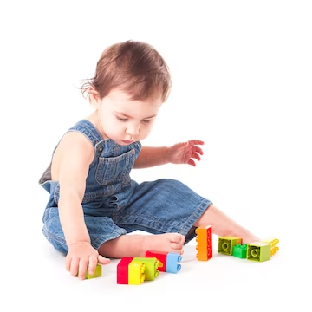
Age at which movements skills are achieved:
Age Range(months) | Motor Milestone
0.7-4.0 | Head held erect
0.7-5.0 | Turns form side to back
1.0-5.0 | Side upright with support
4.0-8.0 | Unilateral teaching
5.0-9.0 | Site alone unsupported
5.0-12.0 | Pulls up to stand position
7.0-12.0 | Walk with assistance
9.0-16.0 | Stands alone
9.0-17.0 | Walks alone

Slide 23
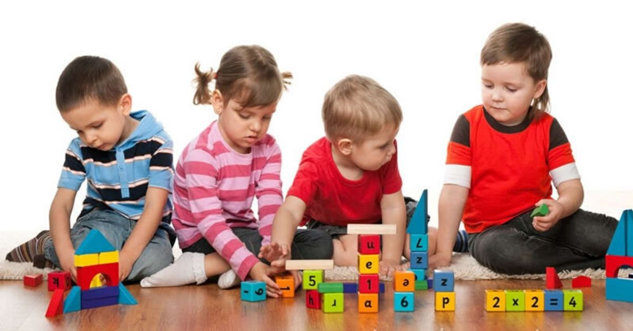
. Early childhood development
Early childhood education or learning focus on children learning through play. There are different developmental domains of children which all relate to each other: Physical development - Concerning the physical growth and the development of both gross(eg . Walking, jumping, running etc) and fine motor(eg, drawing, writing , pasting, cutting, and manipulation of small objects and instruments.)
Although children of this age have been weaned, they remain dependent on adult support, mainly because of their still developing cognitive and movement capabilities. Early childhood is a time for developing mastery in basic movement skills and for testing oneself physically in different environments.
Psychology > developmental psychology > physical development and growth.

Slide 24

. Later childhood development
Late childhood introduces a child to the outer world for the first time. Between 9 to 12 years is the late childhood age. In between this stage, children develop very quickly. Some various types of development occur in Late Childhood.
Differences in size between boys and girls are insignificant during both early and later childhood phases. However, an extremely important differences does appear at the end of later childhood, as girls enter puberty sometime before boys. Girls, later childhood period ends at about 10years of age, for boys, it is at about 12years.

Slide 25
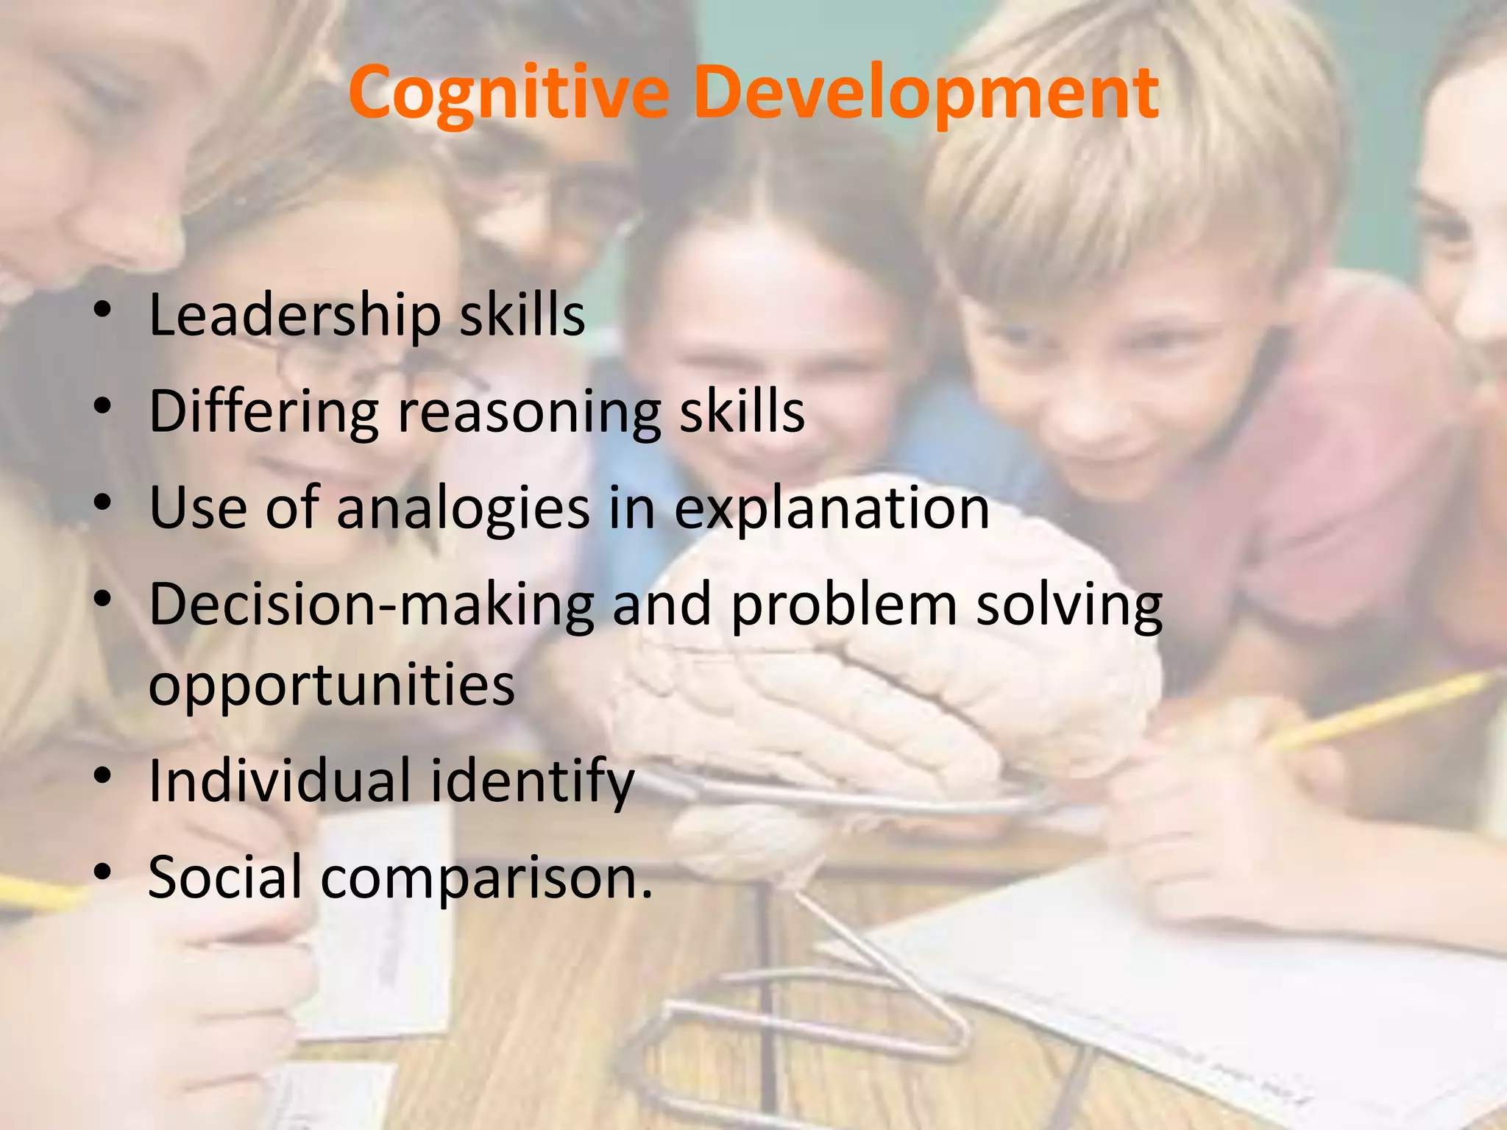

Slide 26
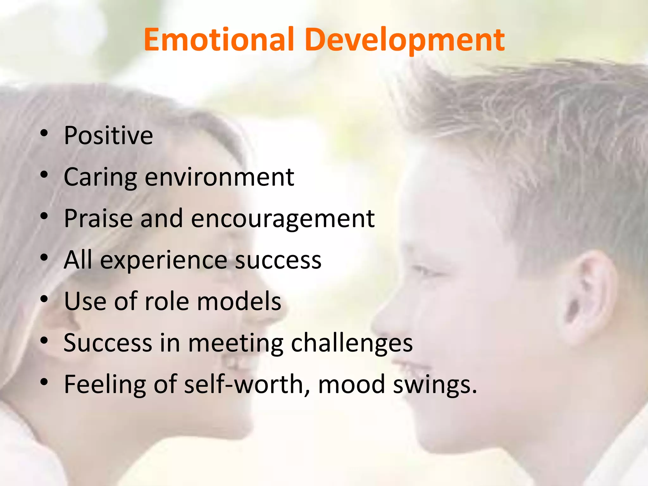

Slide 27
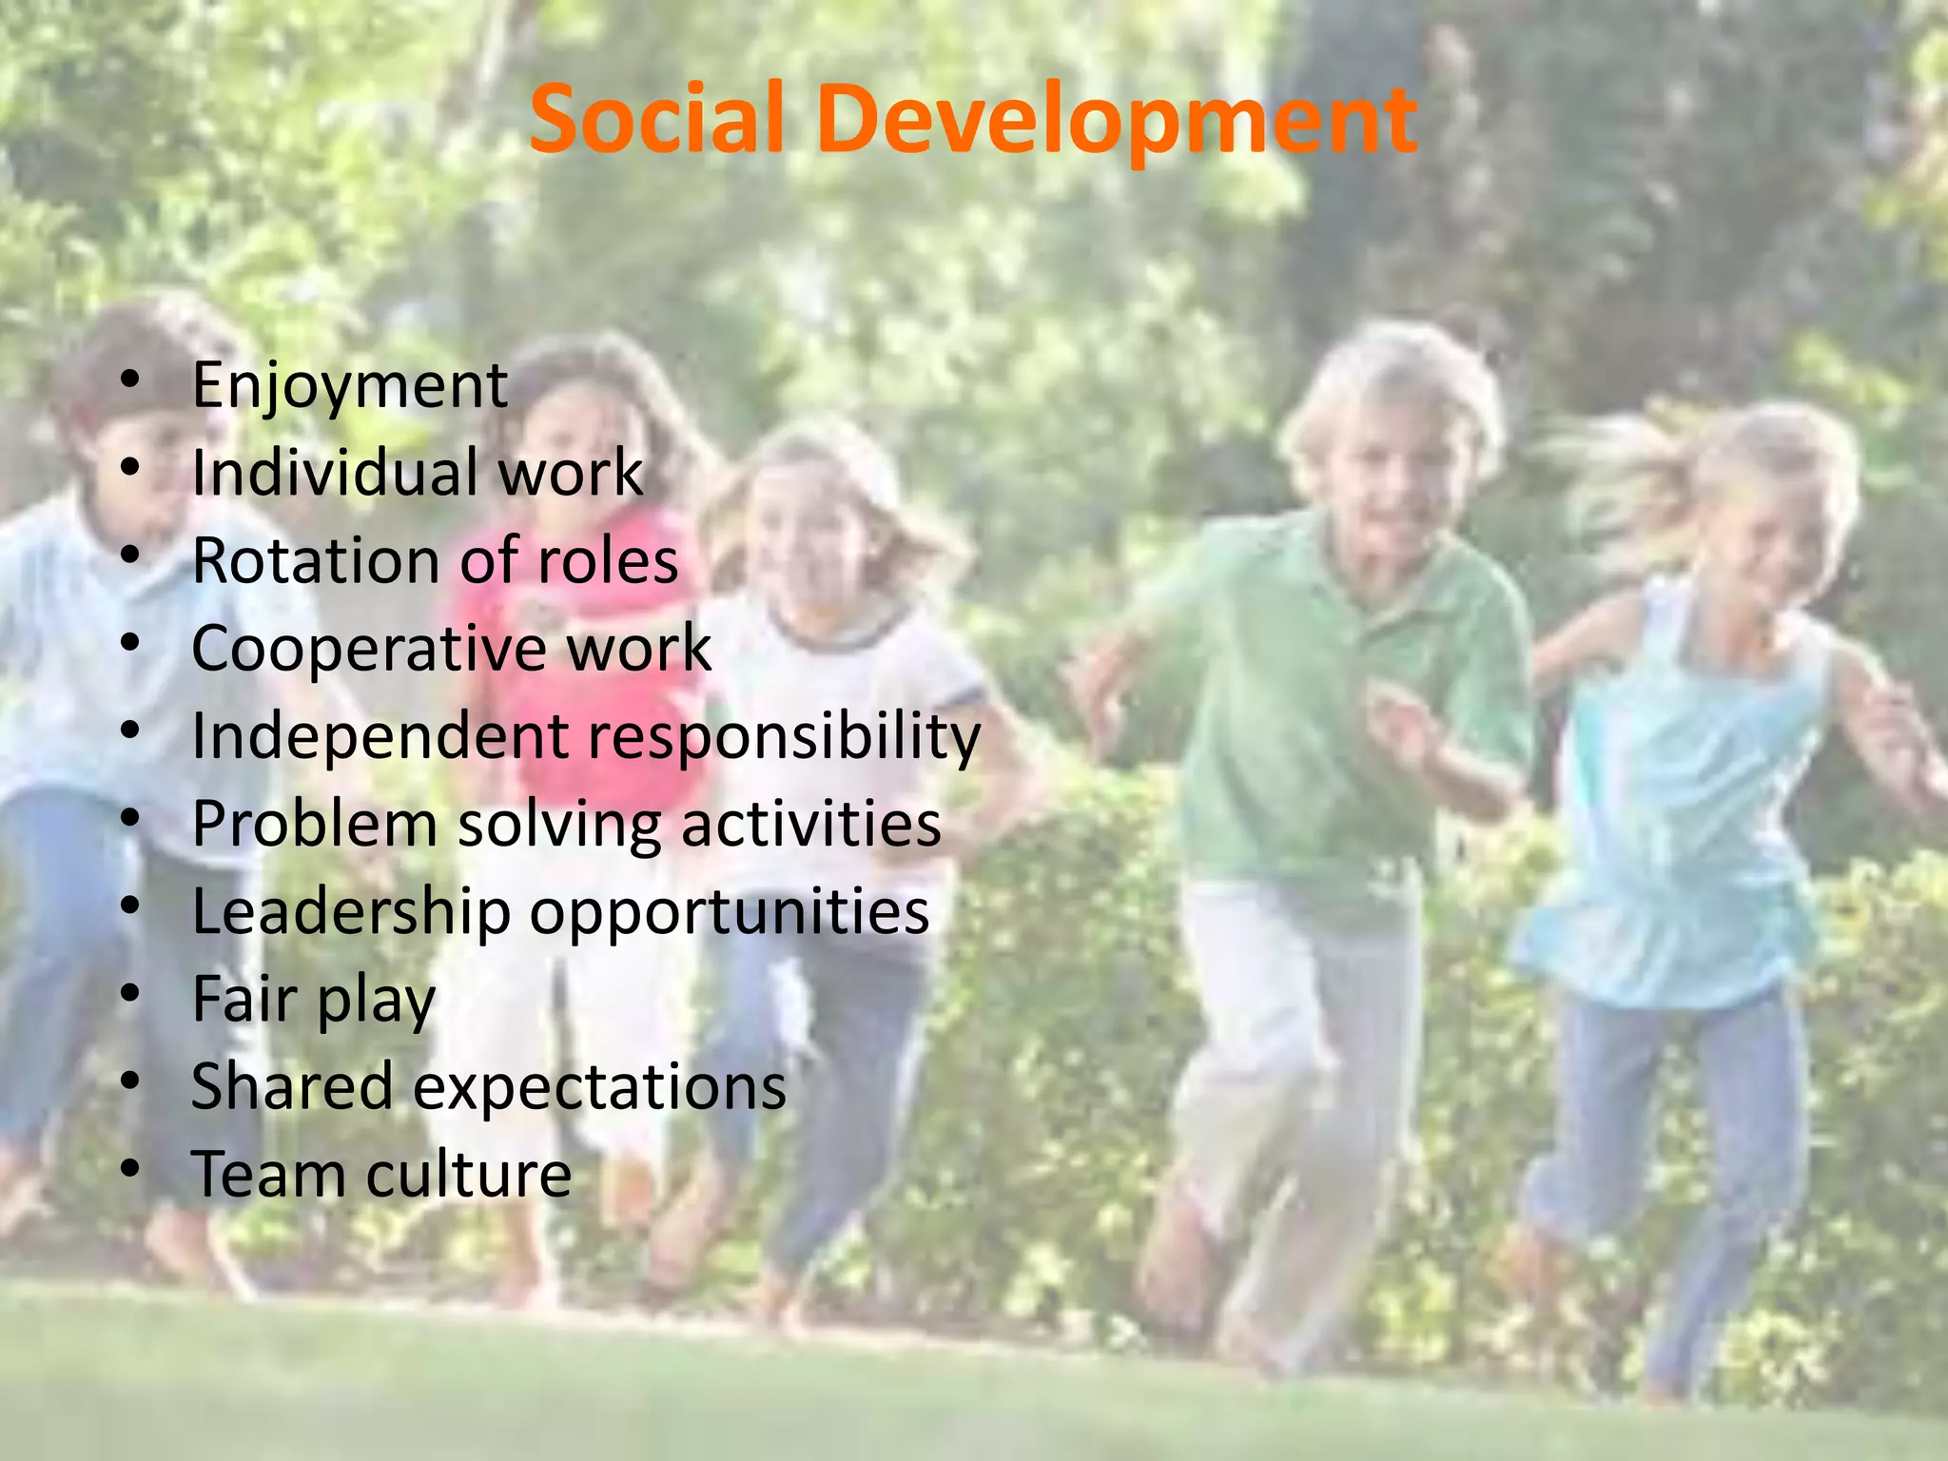

Slide 28
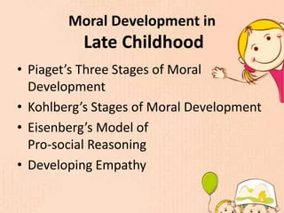
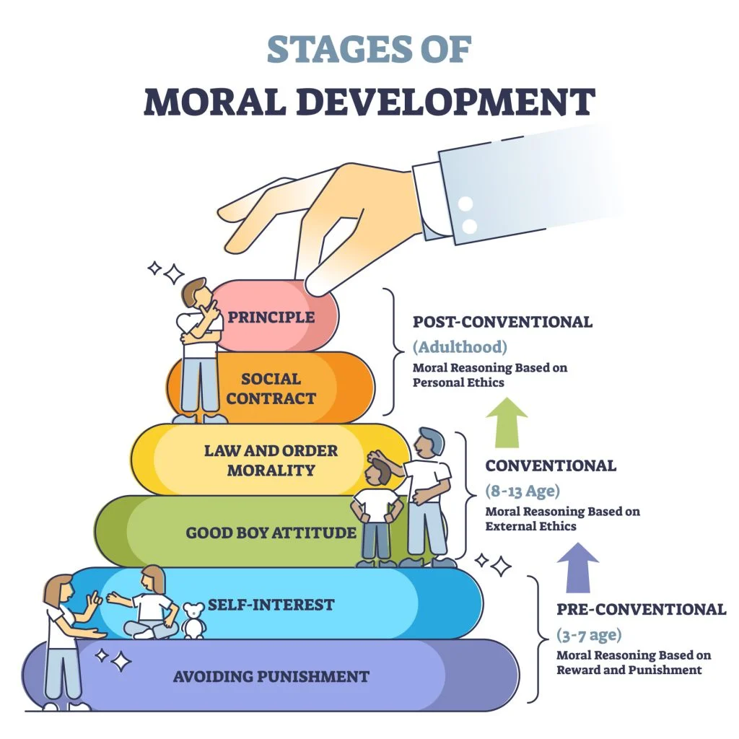

Slide 29
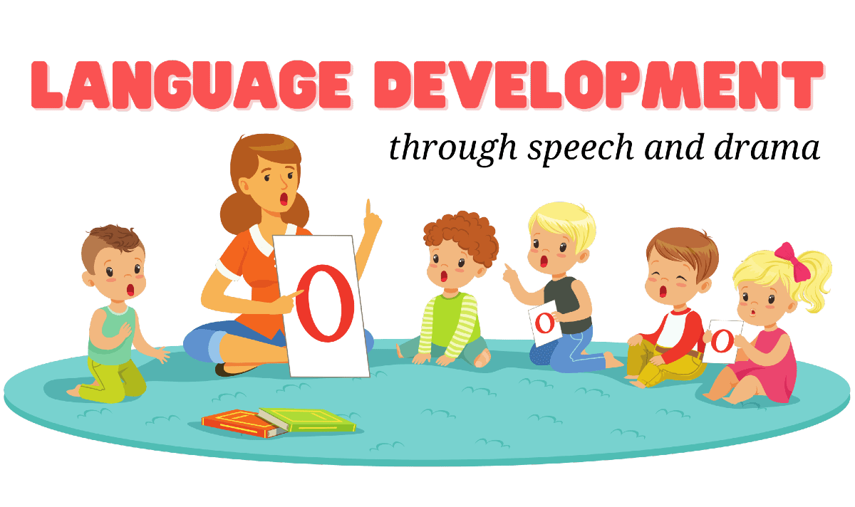
Language development in children is the process through which we gain the ability to comprehend and communicate through speech. Before acquiring fluency, a child may progressively comprehend fundamental verbal patterns and increase their vocabulary throughout this stage.
Language development starts with sounds and gestures, then words and sentences. You can support language development by talking a lot with your child, and responding when your child communicates. Reading books and sharing stories is good for language development..

Slide 30
. Phases of developmental and development task
Stage:1 Infancy:
Trust vs mistrust
Trust | Mistrust
When caregivers respond promptly to an infants cries, the baby can learn to rely on others. As caregivers fill an infants needs, the baby can develop a sense of trust and security. | If caregivers neglect an infants, needs, or if care is sporadic, an infant may grow insecure. They may learn they cannot rely on others and thus feel unsafe.

Slide 31
Stage:2 Toddlerhood:
Autonomy vs Shame and Self-doubt
Autonomy | Shame
In this stage, caregivers often serve as a safe base from which to explore the world. When caregivers encourage independence, children will feel secure enough to take risks. | Children whose caregivers discourage them may develop feeling of shame. If caregivers foster excessive dependence, the child may learn to doubt their own abilities.

Slide 32
Stage:3 Preschool years:
Initiative vs Guilt
Initiative | Guilt
When caregivers nurture these tendencies, children learn how to make decisions and plan for the future. They can grow in to adult who are able to follow their ambitions. | If children are criticized for being assertive, they may feel guilt for pursuing their desires. Controlling caregivers may teach children to follow another lead rather than starting their own plans..

Slide 33
Stage4: Early school years:
Industry vs Inferiority
Industry | Inferiority
Children who are accomplished compared to their peers can develop self-confidence and pride. Praise for their achievements can boost their self-esteem. | Children who do not achieve certain milestones may doubt their abilities or self-worth. When children are constantly criticized, they may develop feelings of inferiority.

Slide 34
Stage:5
Adolescence
Identity vs Role Confusion
Identity | Role Confusion
To succeed in this stage, adolescents need to establish a coherent sense of self. They will need to determine their priorities in life. Then they will need to set goals for their adult selves based on those values. | Some adolescents may have a weak sense of self. They may struggle to break away from the person their parents or peers expect them to be. Without a consistent identity, they may grow confused about what they truly want for the future.

Slide 35
Stage:6
Young Adulthood
Intimacy vs Isolation
Intimacy | Isolation
Relationships can be a key source of affection and intimacy in adulthood. Many find emotional benefits from having a committed, lifelong bond. | According to Erikson, people who do not develop relationships may become socially isolated. They may develop long-term feelings of loneliness.

Slide 36
Stage:7
Middle
Adulthood
Generativity vs Stagnation
Generativity | Stagnation
People may offer guidance to the next generation through parenting or mentorship. They may also offer lead the way by leaving a legacy. Contributing to society's future can give people a sense of community and purpose. | Some people may feel as if they have no impact on society. If people do not find their work meaningful, they may feel restless or isolated. Some may feel they have “peaked” and that their lives will only get worse in the future.

Slide 37
Stage:8
Late
Adulthood
Ego Integrity vs Despair
Ego Integrity | Despair
Those who feel fulfilled by their lives can face death and aging proudly. | People who have disappointments or regrets may fall in to despair.

Slide 38
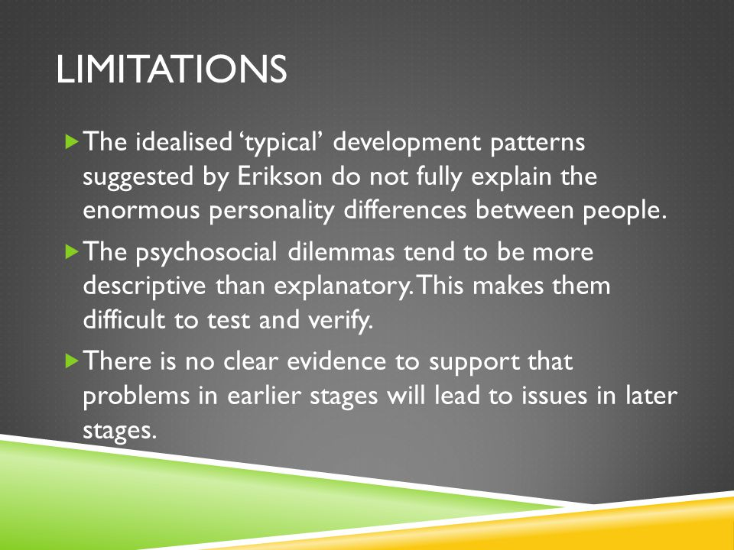
. Limitations of Erikson's 8 stages of development

Slide 39
INFANCY STAGE:
The Infancy stage is the earliest stage in life, typically lasting from birth to about 2 years old. During this stage, infants learn to develop their abilities to think, feel, and move. They also learn how to interact with the people and things around them. It's extremely rare for anyone to remember their own infancy. An amazing amount of growth and development happens during infancy: babies learn to crawl, laugh, and communicate, among many other things.
CHILDHOOD STAGE:
It covers the whole period from conception to an individual becoming a fully functioning adult. It's a journey from total dependence to full independence. Child development incorporates, physical growth as well as intellectual, language, emotional and social development.

Slide 40
ADOLESCENCE STAGE:
Adolescence is the period of transition between childhood and adulthood. Children entering adolescence are going through many changes in their bodies and brains. These include physical, intellectual, psychological and social challenges, as well as development of their own moral compass.
During adolescence the desire for independence and autonomy increases, and parents usually find themselves much less thrilled with the developmental indicators of this increasing maturity.

Slide 41


